Slide 1
Welch Wolf Pack Volleyball Parent Meeting
Coach Cordova, 8th Grade Coach and US History Teacher
Coach Washington, 7th grade Coach and Physical Education Teacher

Slide 2
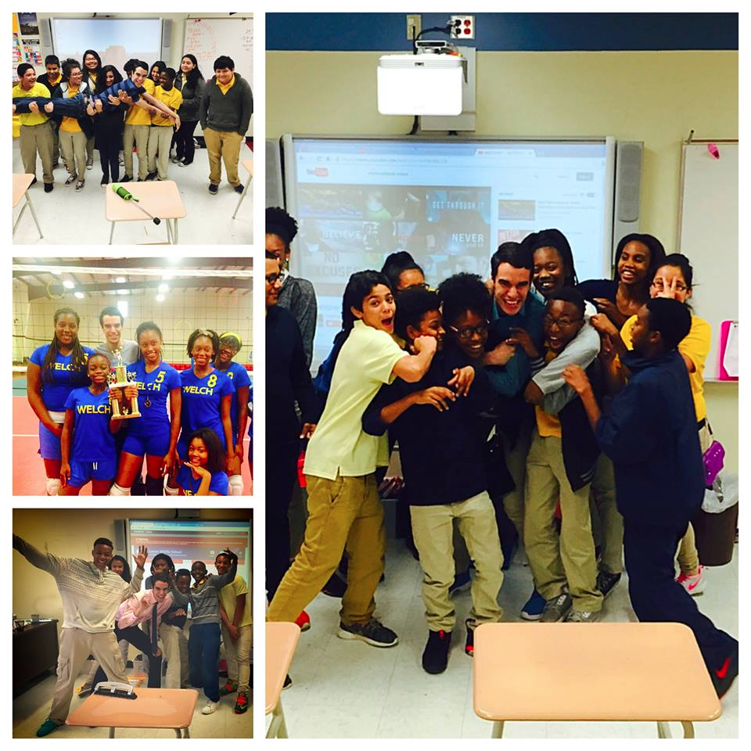
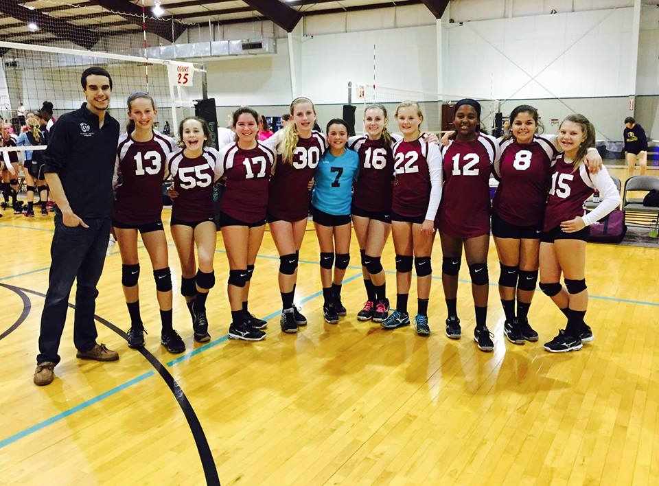
Coach Cordova
2nd year teacher here at Welch MS
4 year Volleyball player at UTSA and President/Captain my Senior year
7th grade Volleyball coach last year
Coached club volleyball at the 15s age level with San Antonio Lightning and coaches at the 13s age level with Pearland Juniors here in Houston

Slide 3
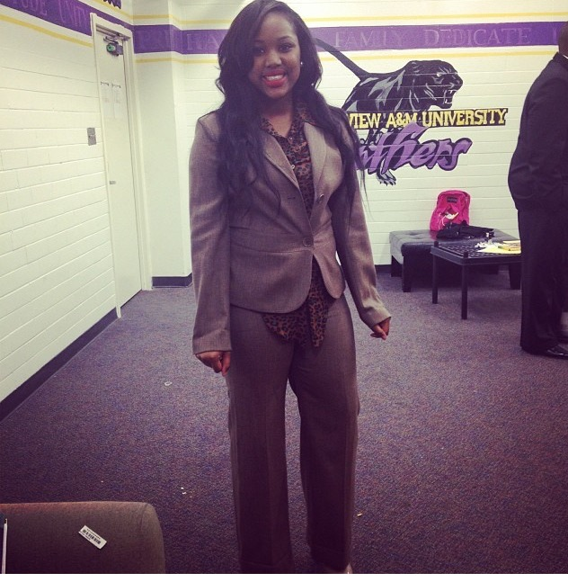
Coach Washington
Coach Washington is a former graduate from Prairie View A&M University. Growing up her life revolved around sports by playing in basketball and volleyball leagues. Her drive as a high school athlete helped her attain varsity status as a sophomore in volleyball and basketball. Coach Washington has always had a passion for sports which lead to becoming a physical education teacher and coach.
Washington’s philosophy is hard work beats talent when talent isn’t working hard. This means that every athlete has the opportunity to grow through hard work and dedication.

Slide 4
Volleyball-The Ultimate Team Sport
https://www.youtube.com/watch?v=b-1lZ9-uWm4
Gets your student involved!
More inclined to do well academically!
Foster Positive Relationships!
Prepared for High School Volleyball!
Potential College Scholarship!

Slide 5
Paperwork
We will fill out these forms together!
Parent Approval form
Acknowledgment of rules form
Concussion Acknowledgement form
Sudden Cardiac Arrest form
HISD Insurance (35$ cash) or HISD Insurance Athletic Waiver (must be notarized)
Student Media Release Consent form

Slide 6
Physicals
This Saturday from 9-10:30 or Monday from 4:30-5:30 am here at Welch MS
15$ Cash
Please bring form to physical!
Give paperwork in the morning to Coach Cordova on Monday Aug 31st to be clear for tryouts!

Slide 7
Tryouts
Monday August 31st 4:10-6:10 pm
Must have all paper work in file before tryout!
Be dressed out in a tee shirt, spandex, and athletic shoes at the gym. NO LATE ARRIVALS!
-Names of athletes who made the team will be posted on the team website at 7pm that night
-Athletes who made the team are to report to Coach Cordova's classroom (415) for the first team meeting/practice on Tuesday September 1st by 4:10pm.

Slide 8
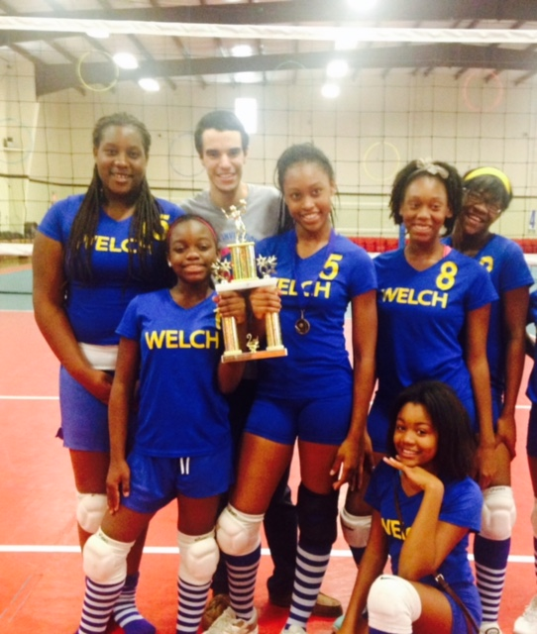
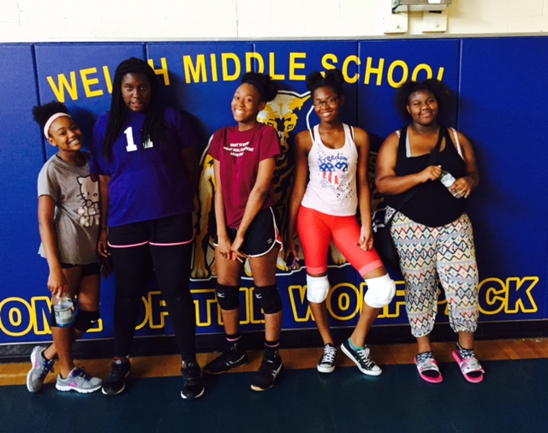
2015-2016 Season
Lets review our schedule for this season!

Slide 9
Expectations
Lets review our expectations of our athletes!
For parents:
Timely pick up after practice/games
Assist with organization (must be a VIPS)
Be supportive to your daughter

Slide 10
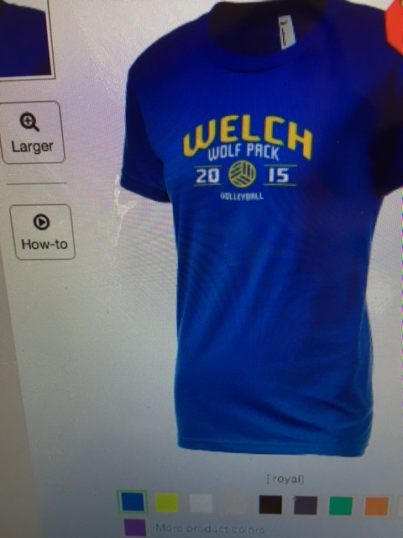
Fundraiser 2015-2016
Welch Wolfpack T-Shirts!
25$ in cash!
Order forms will be given to girls on Tuesday at first official practice!

Slide 11
Questions?
http://welchvolleyball.weebly.com/
Coach Cordova
jcordov5@houstonisd.org
281-740-9724
Coach Washington
bwashi13@houstonisd.org

